Slide 1
World Ranking Universities Analysis

Slide 2
Introduction
The project focuses on analyzing World University Rankings across multiple years using both Python (Jupyter Notebook) and Power BI. It aims to:
Clean and preprocess the dataset.
Explore patterns and rankings of universities worldwide.
Answer SQL-style analytical questions programmatically.
Build interactive dashboards in Power BI for visual insights.

Slide 3
Methodology
Data Source : CSV file containing global university ranking.
Data Cleaning in python :
Handled Missing values.
Removed duplicates.
Fixed column naming inconsistencies.
Analytics Steps :
SQL-style queries applied via pandas to extract insights.
Key ranking attributes analyzed: Quality of Education, Quality of Faculty, Alumni
Employment, Citations, Publications, Patents, Influence, National Rank.
Visualization in Power BI :
Dashboards created with bar charts, line charts, and KPI cards.
Filters and slicers applied for country-wise and year-wise analysis.

Slide 4
Requirement Analysis
Identify top universities by year and country.
Compare scores and ranks based on different parameters.
Understand country-level distribution of universities.
Track trends over multiple years.
Provide both tabular (queries) and visual (Power BI) outputs.

Slide 5
Other Parameters
Temporal Dimension: Yearly comparisons (2012–2014).
Performance Indicators: Education quality, faculty strength,
alumni employment, patents,
citations, influence, national/global rank.

Slide 6
Visualizations
Bar Charts: Top universities by score, alumni employment,
publications.
Line Charts: Trend of rankings over years.
Maps: Distribution of universities by country.
Tables: Top N universities filtered by year and parameter.
Cards/KPIs: Total universities, average scores, top-ranked
institutions.

Slide 7
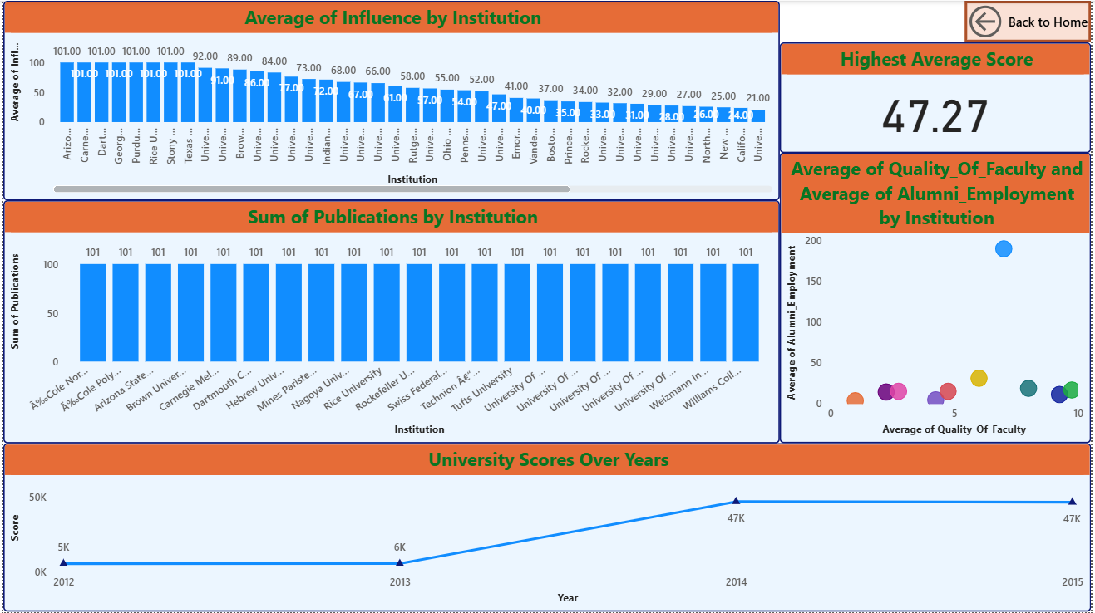

Slide 8
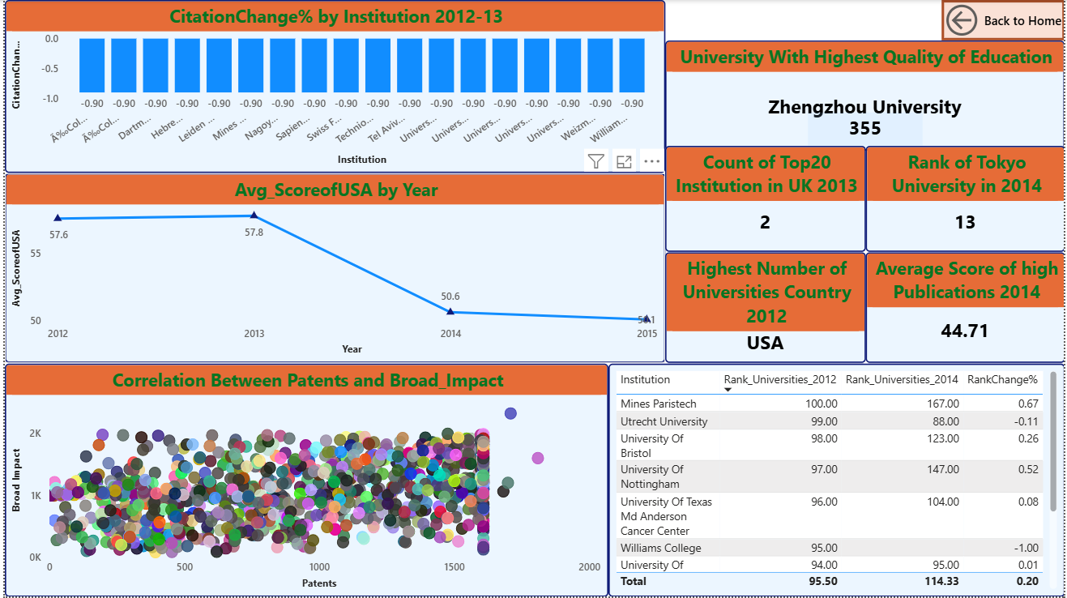

Slide 9
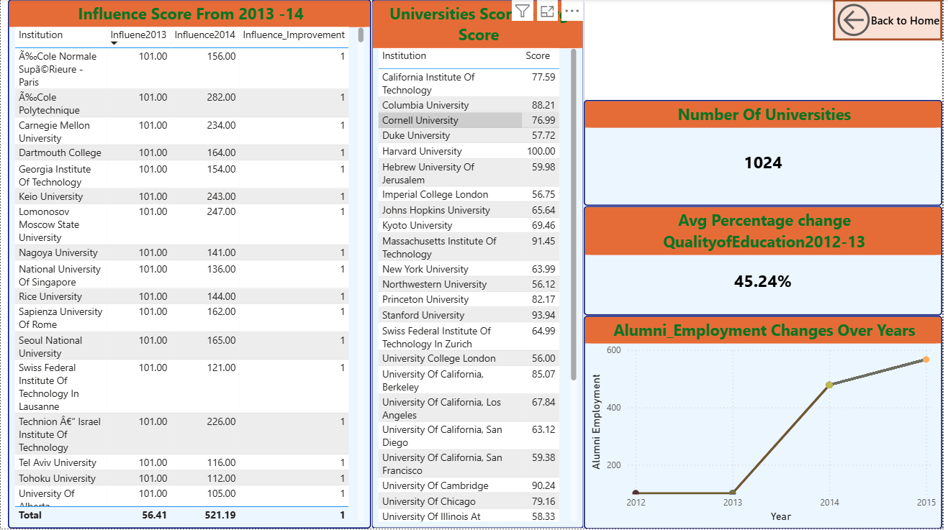

Slide 10
Insights
Top Performers: USA and UK universities dominate global rankings.
Yearly Trends: Some universities consistently remain in the top 10, while others fluctuate.
Alumni Employment: Strongly correlated with global prestige (e.g., Harvard, Oxford, Cambridge).
Faculty Quality & Citations: Universities with strong research output lead in citations and influence scores.
Country-wise Distribution: USA has the maximum representation, followed by UK, China, and Japan.
Improvement Cases: Some Asian universities (Japan, China) show rising trends in rankings over the years.
Parameter Variations: High citations do not always translate into high alumni employment or education quality, showing multidimensional evaluation.

Slide 11
Conclusion
Python handled data preprocessing and query-based
exploration.
Power BI provided interactive dashboards for stakeholders to
visualize insights.
The study highlights dominance of US/UK universities but
also growth of Asian universities.

